Slide 1
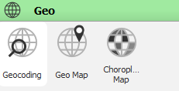
Additional Details on GeoMap and Choropleth Map
Jurgen & Pedro

Slide 2
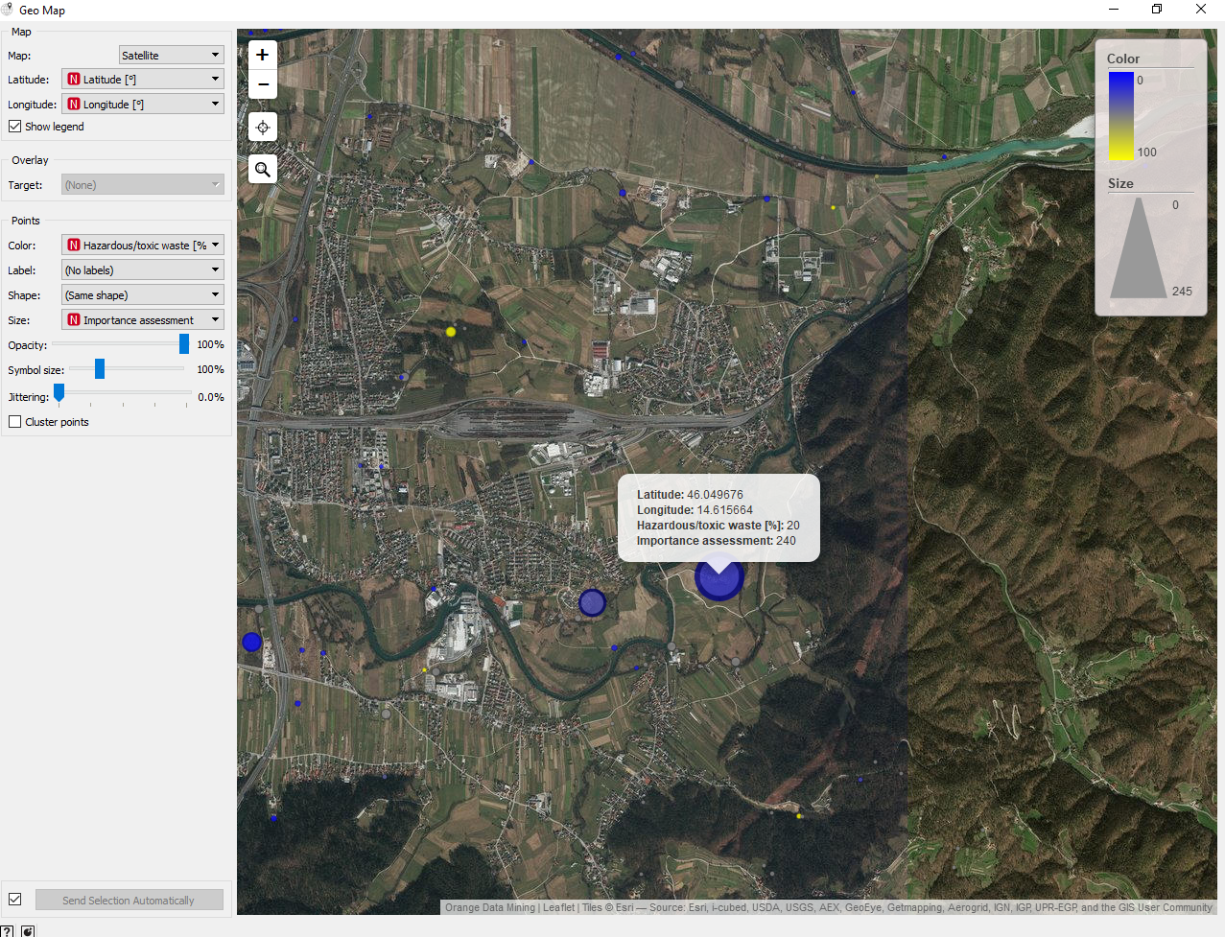
geomap not toxic but high importance

Slide 3
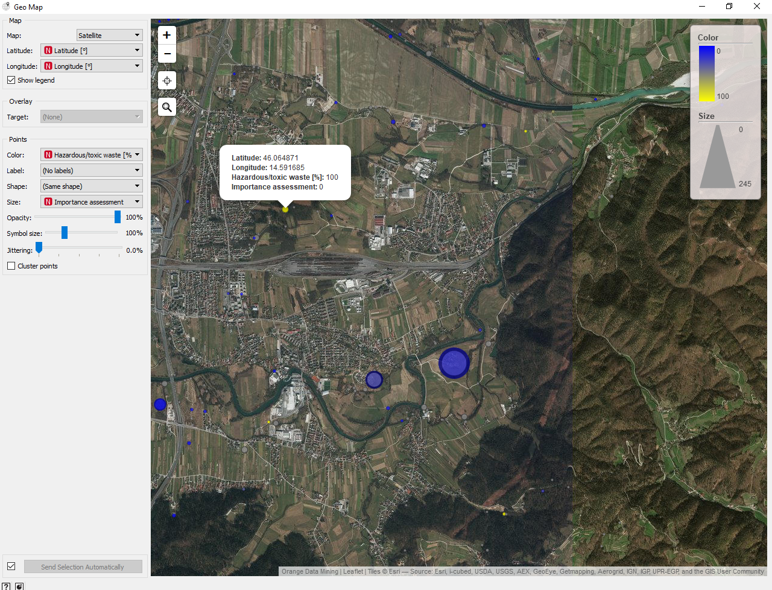
geomap toxic but little importance

Slide 4
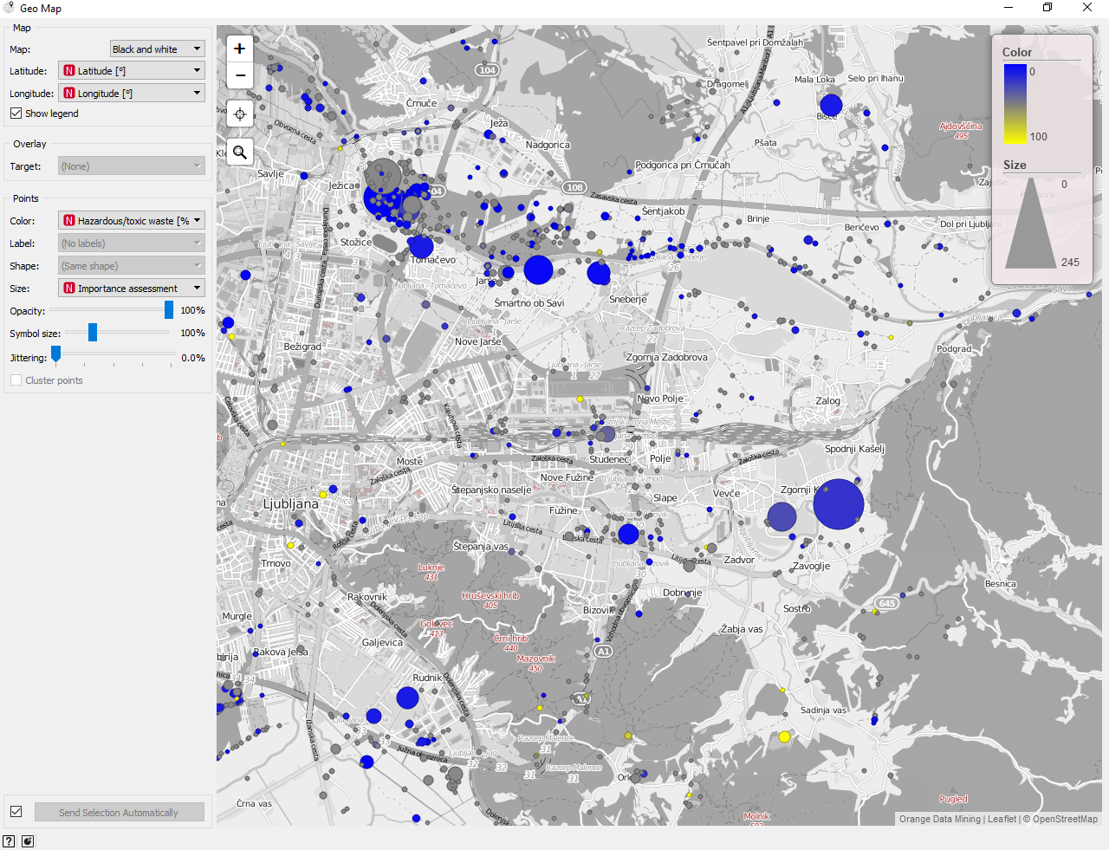
map black and white

Slide 5
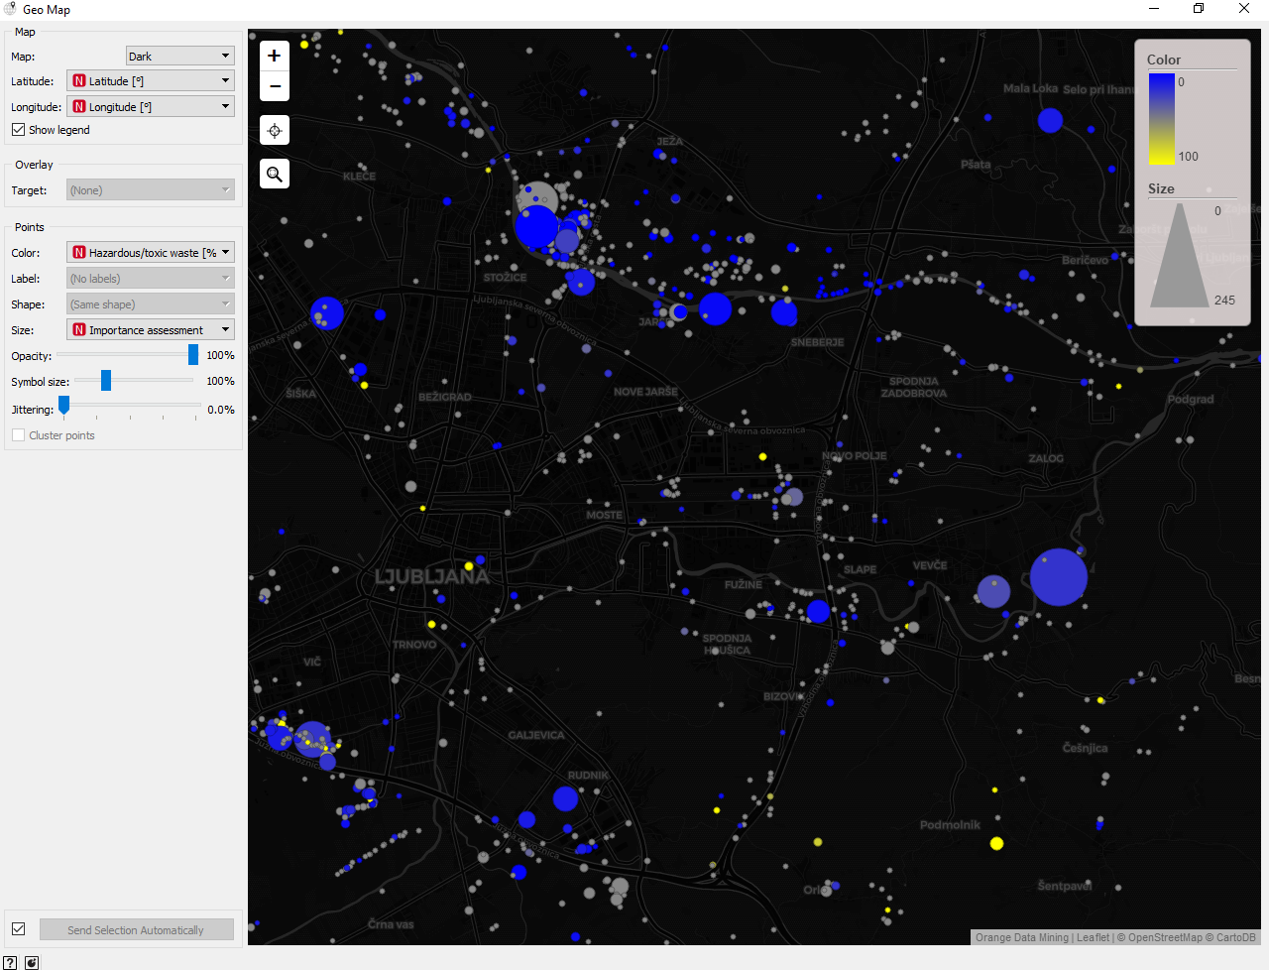
map dark

Slide 6
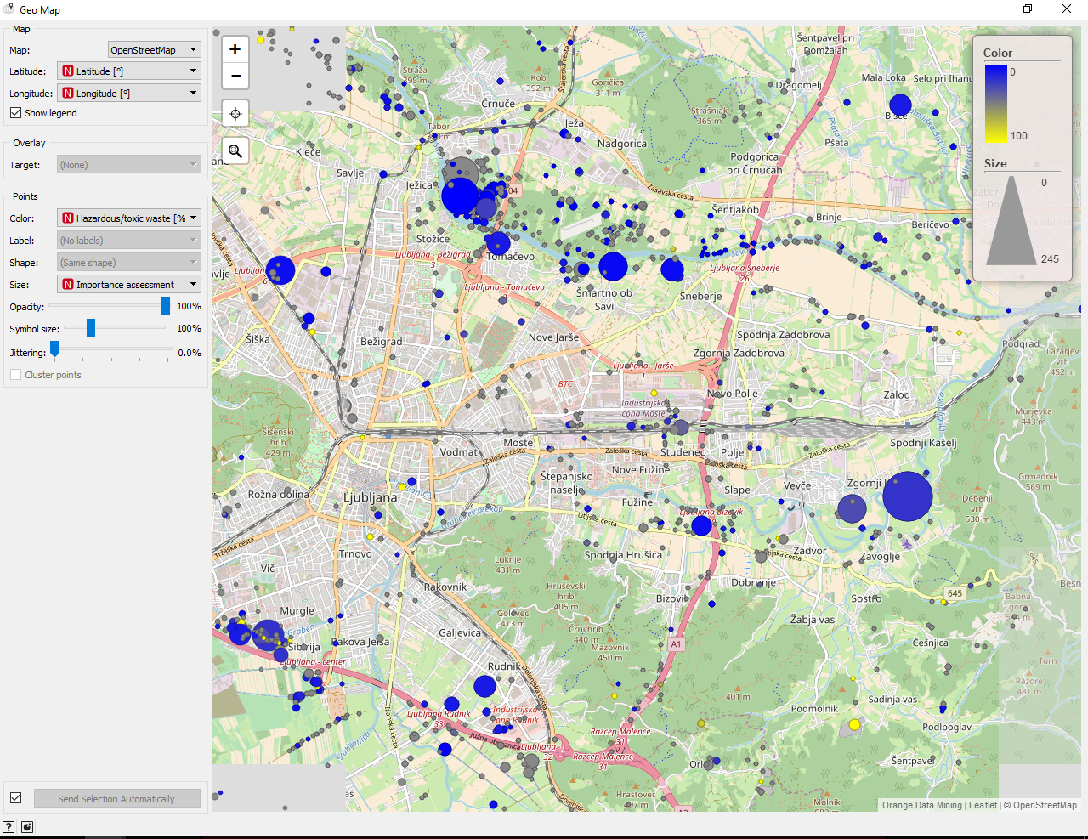
map open street map

Slide 7
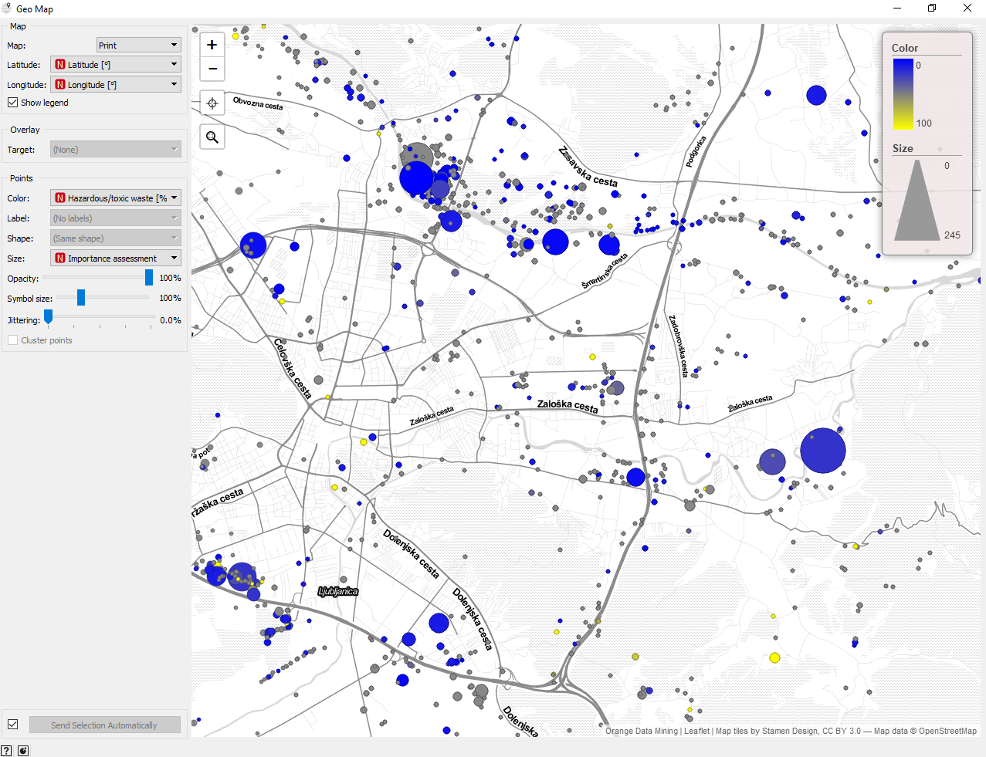
map print

Slide 8
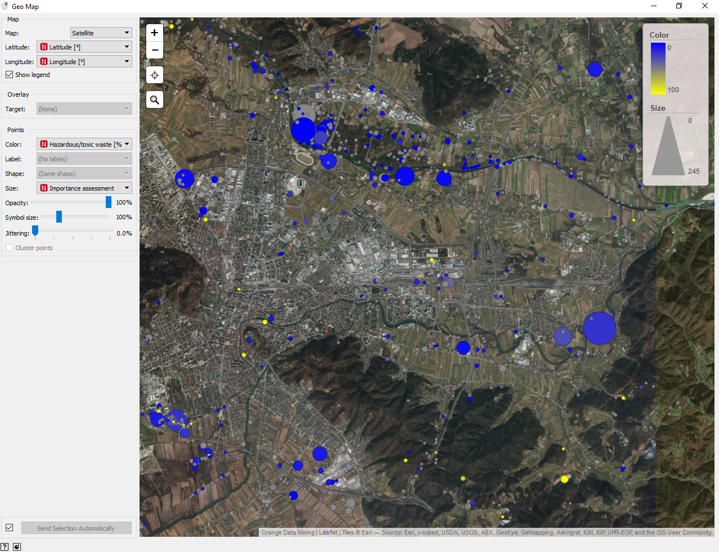
map satellite

Slide 9
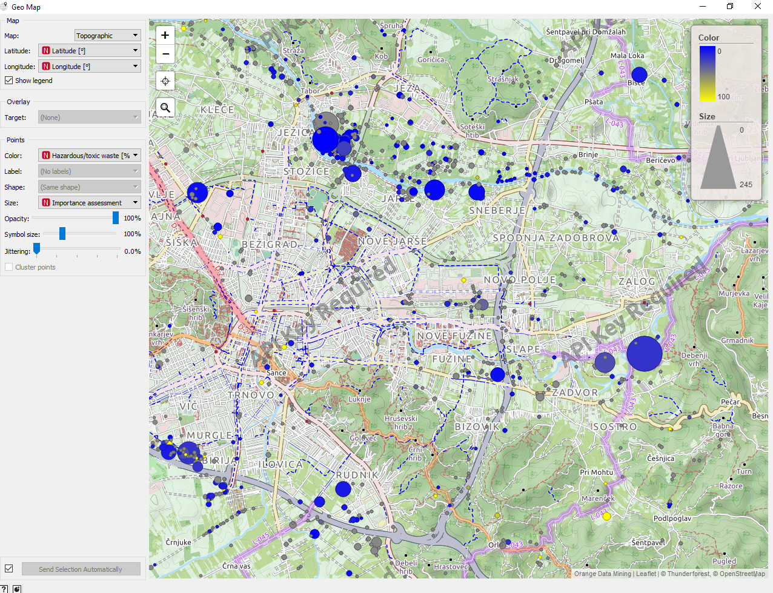
map topographic

Slide 10
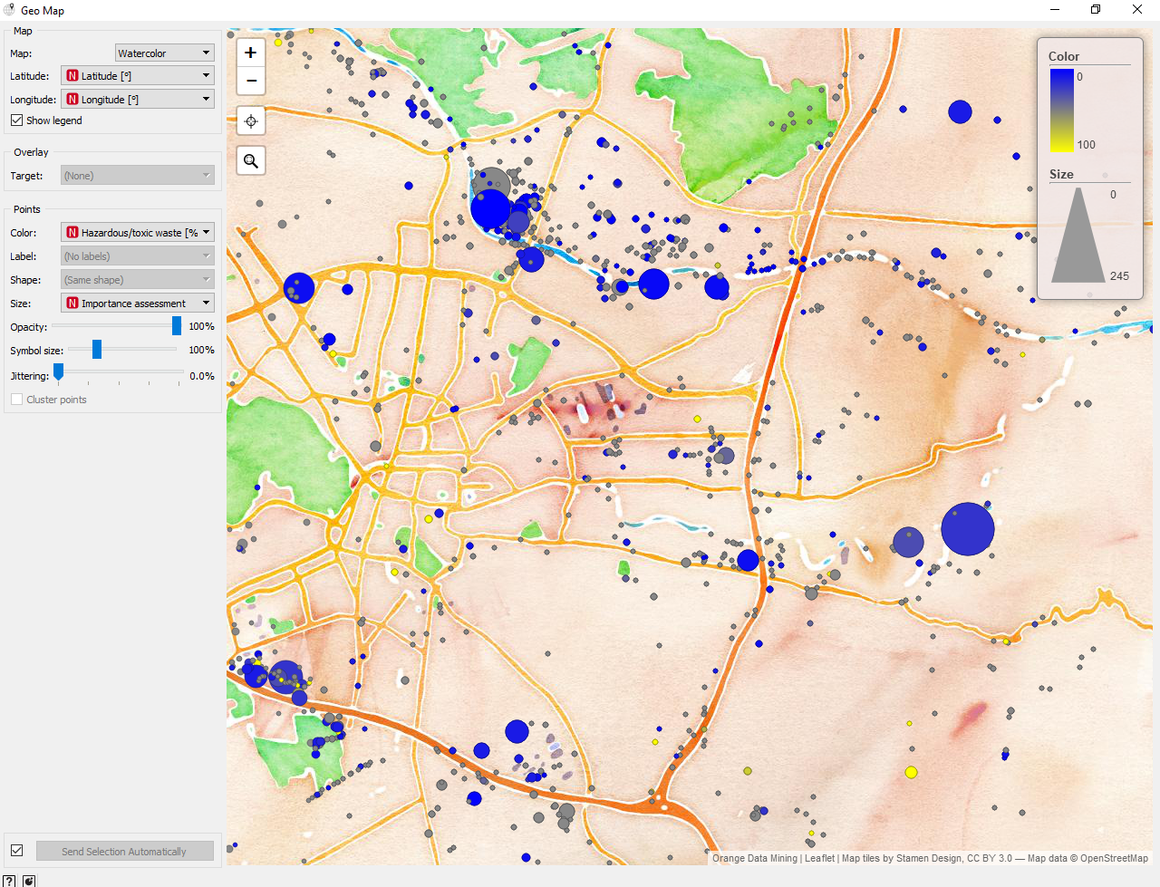
map watercolor

Slide 11
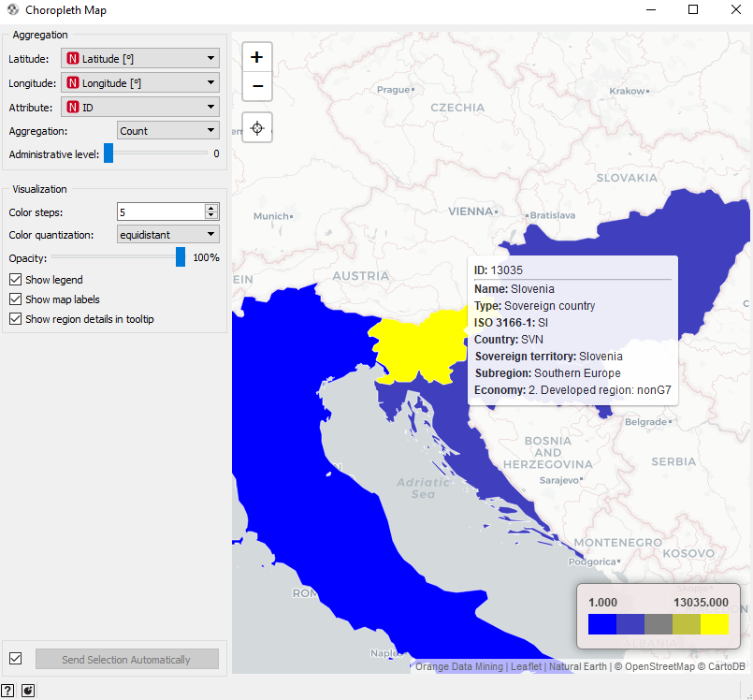
choropleth map countries

Slide 12
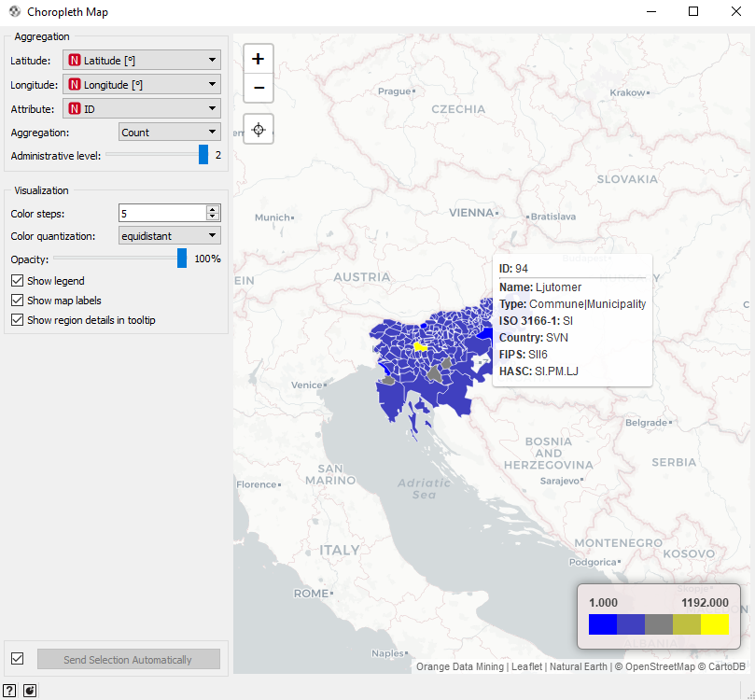
choropleth map regions or cities

Slide 13
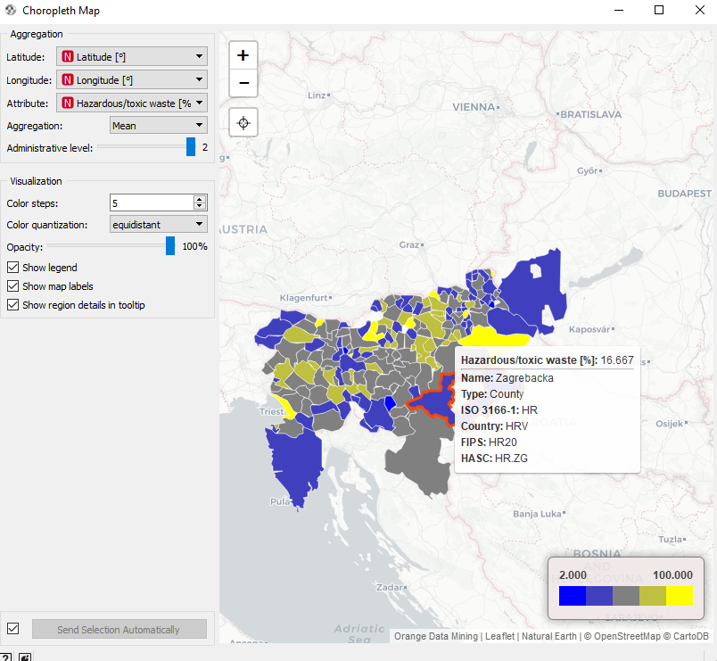
choropleth map regions or cities by toxic material (average)

Slide 14
END

